Slide 1
Student Navigators Meeting

Slide 2


Slide 3
Agenda
Introductions
Review of grant focus and commitment
Student intake
  Required elements
  Desired elements
  Screening for employability
  Resources (veterans, PLA)
Monthly meetings
  Format
  Topic for May—WA St Labor Council
  Topics for future meetings

Slide 4
Introductions
Andy Brucia- BC
Adriana Ghan-CC
Beth Jorgenson-NOVA
Fran Kwak-RTC
Laura Nelson-BTC
Natalie Washington-WCC

Slide 5

Notes:
Share one interesting fact about yourself or one interesting experience you’ve had.

Slide 6


Slide 7
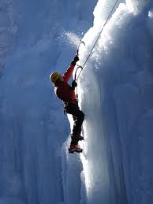

Slide 8
Grant Overview

Slide 9


Health E-Workforce (HeW) grant

Slide 10
Key HeW grant elements
Training unemployed workers in high-demand fields
Stackable credentials
Evidence-based design
Innovation
PLA
Practices to promote student retention & completion

Slide 11
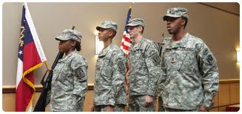

HeW key areas of focus
Notes:
Veterans, TAA-eligible workers, and others

Slide 12
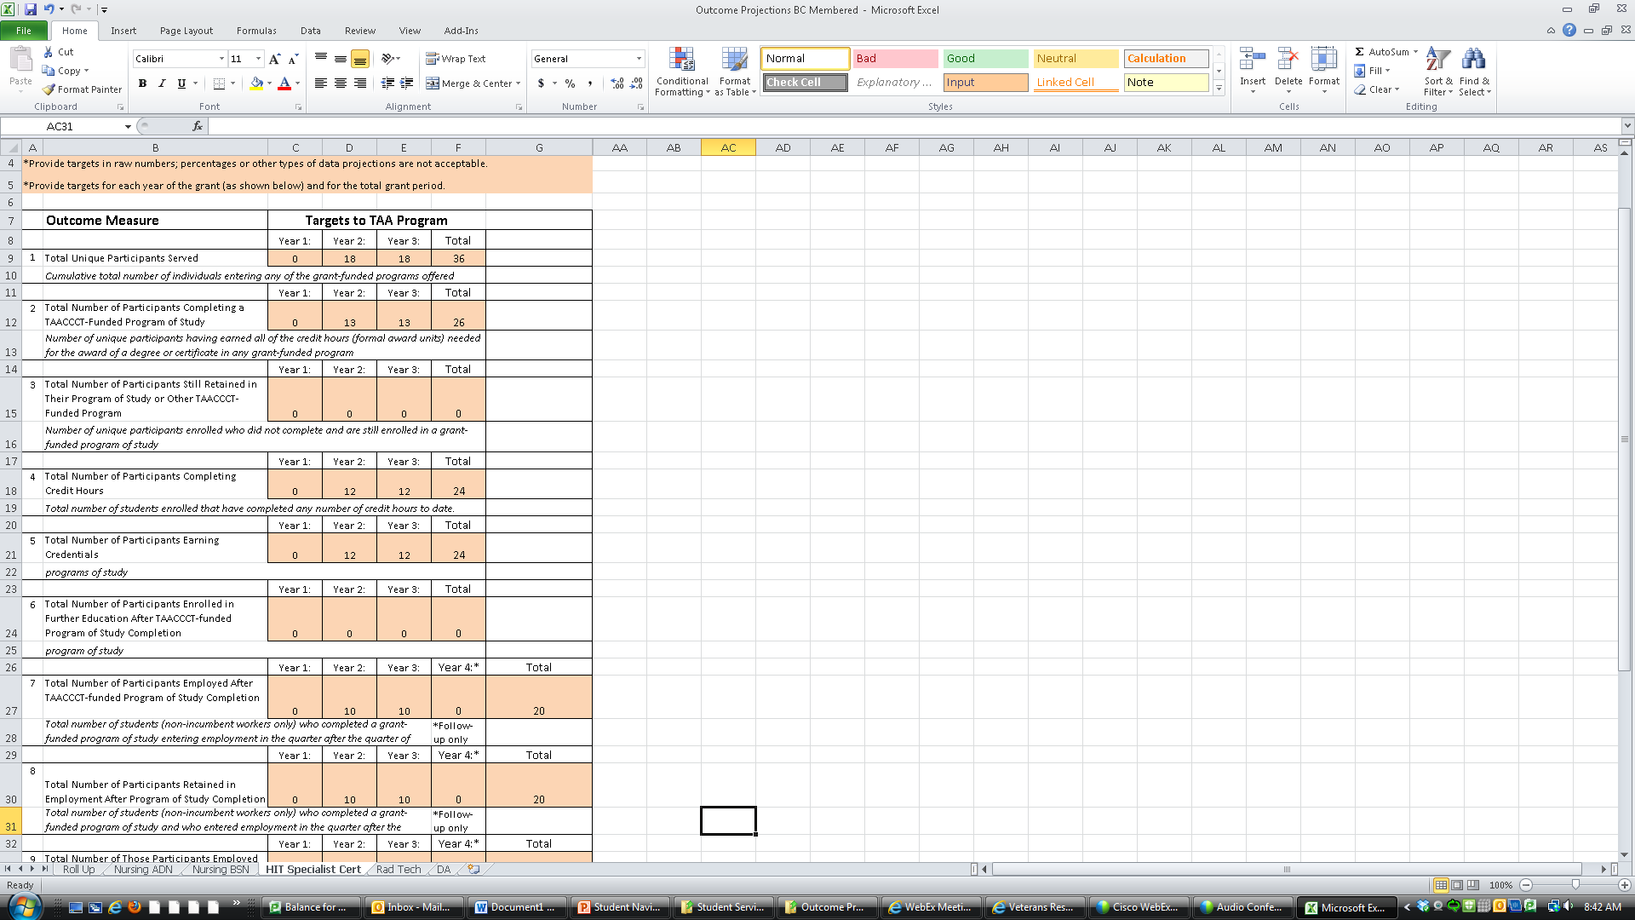
What we promised: student outcomes

Slide 13

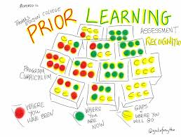
What we promised: strategies to increase student retention & completion

Slide 14

What we promised: continuous improvement

Slide 15
Student Intake
          Required elements
          Desired elements
          Database
          Screening for employability
          Resources

Slide 16
Resources
http://hiteducation.org
Veterans http://hiteducation.org/bc-students/veterans-resources/
PLA

Slide 17
Future Meetings

Slide 18

Poll

Slide 19

whiteboard

